Slide 1

Coding & Decoding
Placement Preparation
Aptitude & Reasoning
Prof. Krunal D. Vyas
Computer Engineering Department
krunal.vyas@darshan.ac.in
9601901005

Slide 2
Introduction
It is a technique to transform the characters in such a way that no third person can understand it.
Approach of solving the question of coding:
a) Observe characters (alphabets/numbers/symbols) given in the code properly.
b) Find the pattern and sequence it follows, whether it is ascending, descending or pair based.
c) Solve the asked characters using the same pattern and sequence.

Slide 3


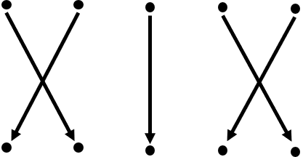
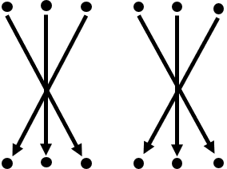
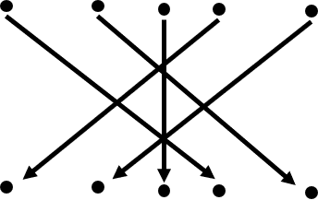
Different types of pattern for coding

Slide 4
Alphabets with numbers
1 | 2 | 3 | 4 | 5 | 6 | 7 | 8 | 9 | 10 | 11 | 12 | 13
A | B | C | D | E | F | G | H | I | J | K | L | M
26 | 25 | 24 | 23 | 22 | 21 | 20 | 19 | 18 | 17 | 16 | 15 | 14
14 | 15 | 16 | 17 | 18 | 19 | 20 | 21 | 22 | 23 | 24 | 25 | 26
N | O | P | Q | R | S | T | U | V | W | X | Y | Z
13 | 12 | 11 | 10 | 9 | 8 | 7 | 6 | 5 | 4 | 3 | 2 | 1

Slide 5
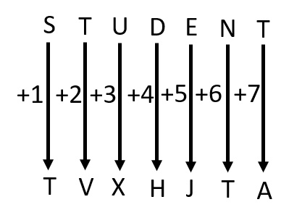
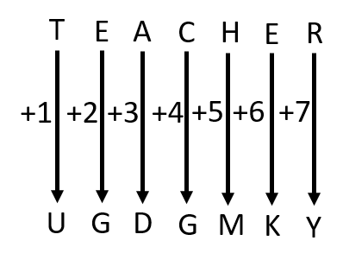
Letter Coding
In letter coding, letters are coded in letters by using different patterns and sequence.
Example: In a certain code language STUDENT is written as TVXHJTA, then how is TEACHER written in same code language?
Solution:

Slide 6
Number Coding
In number coding, letters are coded in numbers by using different patterns and sequence.
Example: In a certain code language ASKED is written 45211, how will EIGHT be written in that code language?
Solution: A = 1, S = 19, K = 11, E = 5, D = 4
• Convert all digits to single digit, we will get 1, (1+9=10, 1+0=1), (1+1=2), 5, 4
• Therefore, number is 1 1 2 5 4. Write it in reverse order “45211”
• Same pattern is used for EIGHT as shown below
• E = 5, I = 9, G = 7, H = 8, T = 20
• Convert all digits to single digit, we will get 5, 9, 7, 8, (2+0 = 2)
• Therefore, number is 5 9 7 8 2. Write it in reverse order “28795”

Slide 7
Conditional Coding
Example: In each of these questions a group of letters is given followed by four combinations of number/symbol numbered (1), (2), (3) & (4). Letters are to be coded as per the scheme and conditions given below. You have to find out the serial number of the combination, which represents the letter group. Serial number of that combination is your answer.
Letter: E Q B K N P L I T C S F H W A
Symbol: 5 * $ 2 © # 4 9 @ 6 1 8 % 7 3
Conditions:
If the first letter is a consonant and the last letter is a vowel, both will be treated as vowel.
If the first letter is a vowel and the last letter is a consonant, the codes will be interchange.
If both the first and the last letters are consonants, both will be coded as ‘d’.
If there are more than two vowels in the group of letters, then all vowels will be coded as ‘&’.
Q-1 IQCPWF
Sol. According to condition (2), the code is 8*6#79
Q-4 IBTNAE
Sol. According to condition (4), the code is &$@©&&
Q-2 KAWILP
Sol. According to condition (3), the code is d379#d
Q-5 IKBQFA
Sol. No condition is satisfied, the code is 92$*83
Q-3 TCKAPE
Sol. According to condition (1), the code is 5623#5

Slide 8
Substitution Coding
In number coding, some particular objects are assigned code names. Then a question is asked that is to be answered in the code language.
Example: If cook is called butler, butler is called manager, manager is called teacher, teacher is called clerk and clerk is called principal, who will teach in class?
Solution: Clearly, a ‘teacher’ teaches in a class and as given ‘teacher’ is called ‘clerk’.
So, a ‘clerk’ will teach in the class. Hence, the answer is ‘clerk’.

Slide 9
Mixed Letter Coding
In this type of questions, three or four complete messages are given in the coded language and the code for a particular word is asked. To analyze such codes, any two messages bearing a common word are picked up. The common code word will mean that word. Proceeding similarly by picking up all possible combinations of two, the entire message can be analyzed.
Example: If ‘nso ptr kli chn’ stands for ‘Sharma gets marriage gift’, ‘ptr lnm wop chn’ stands for ‘wife gives marriage gift’, ‘tti wop nhi’ stands for ‘he gives nothing’, what would mean ‘gives’?
Solution: In the second and third statements, the common word is ‘gives’ and the common code word is ‘wop’. So , ‘wop’ means ‘gives’.

Slide 10
Exercise
Ex-1: In a certain code language, REASONING is written as HZVILTMRM, then how is DIGINOTES written in same code language?
Ex-2: In a certain code language ZEBRA is written as WBYAJ, then how is HORSE written in same code language?
Ex-3: In a certain code language, GGOLD is written as IKUTN, then how is STARS written in same code language?
Ex-4: In a certain code language, RTS is written as 19 and MTH is written as 25, then how is IPL written in same code language?
Ex-5: In a certain code language, PRINTER is written as STJNSCO, then how is DIGITAL written in same code language?
Ex-6: If eye is called hand, hand is called mouth, mouth is called ear, ear is called nose and nose is called tongue, with which of the following would a person hear?
Ans = RTRWMHVGL
Ans = MTIWI
Ans = UXGZC
Ans = 13
Ans = GKHISYI
Ans = nose

